Slide 1



UNIT 5; Healthy and green
Healthy Earth

Slide 2
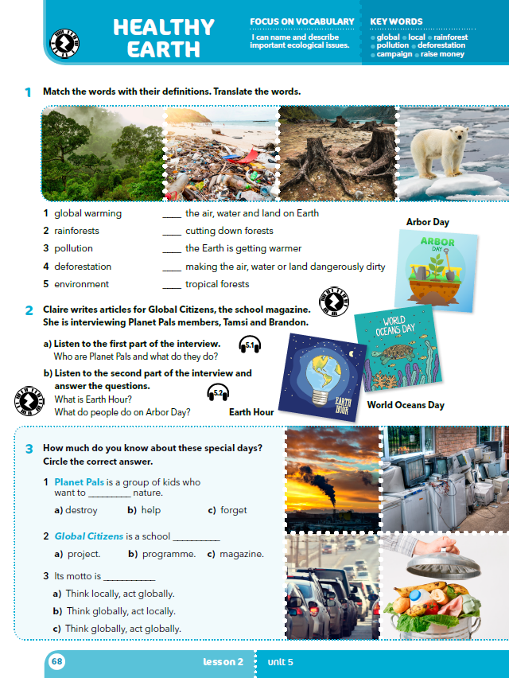
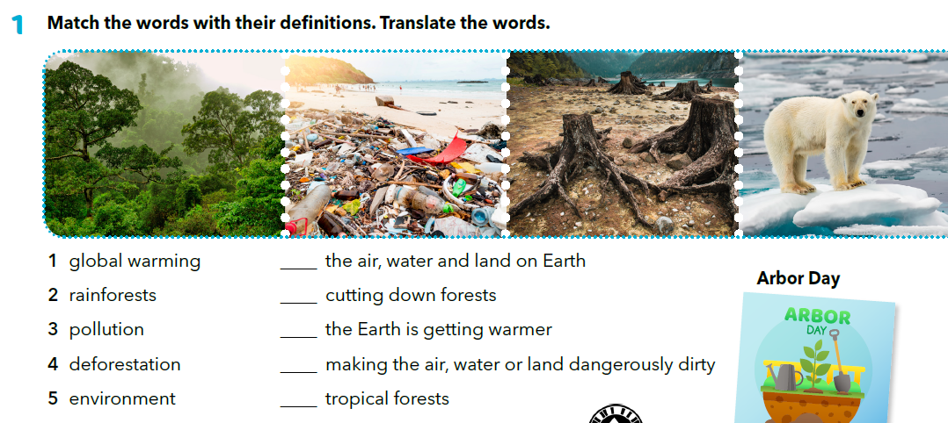
How do we call our planet?
What colour is it when observed from outer space?
Where does the colour come from? What is ozone layer?
What are the conditions on our planet that do not exist on other planets?
What is ecology? Are we completely safe on our planet?
Is there another planet we could live on?
5
4
1
3
2
global warming
rainforests
pollution
deforestation
environment
globalno zatopljenje
tropske šume
onečišćenje, zagađenje
nekontrolirana sječa šuma
okoliš

Slide 3
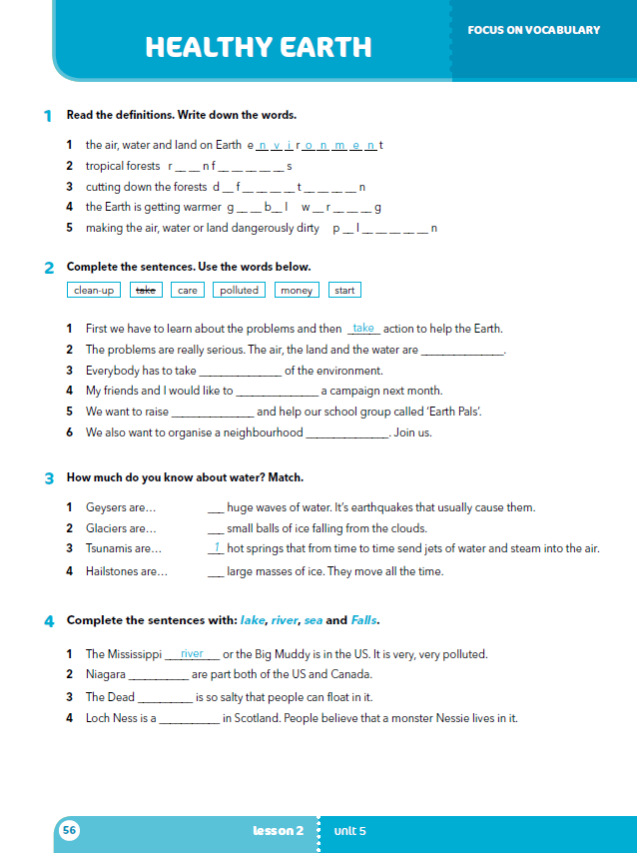
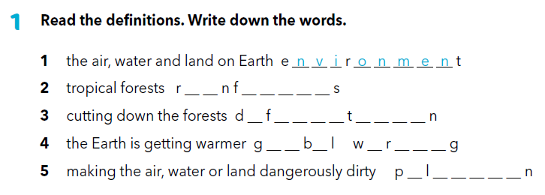
Workbook, p. 56
a i o r e s t
e o r e s a t i o
l o a a m i n
o l u t i o

Slide 4


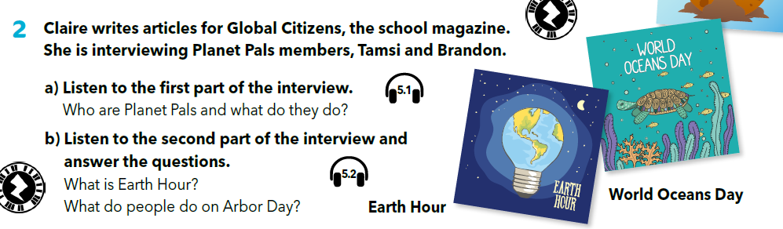
https://www.e-sfera.hr/dodatni-digitalni-sadrzaji/7481817e-5b32-4812-a961-9b2d65e0e498/assets/audio/23__unit_05_lesson_2_-_interview_with_planet_pal_members__-_part_2.mp3
Who are Planet Pals and what do they do? Planet Pals love nature and want to help it.

Slide 5
Listen to the second part of the interview. Which expressions from task 1 did you hear? https://www.e-sfera.hr/dodatni-digitalni-sadrzaji/7481817e-5b32-4812-a961-9b2d65e0e498/assets/audio/24__unit_05_lesson_2_-_interview_with_planet_pal_members__-_part_3.mp3
What is Earth Hour?
During the Earth Hour, people are asked to turn off lights for an hour.
What do people do on Arbor Day?
People plant trees on Arbor Day.

Slide 6
Who is Clair talking to?
What can you say about Global Citizens?
What is Planet Pals?
What are Tamsi and Brandon concerned about?
What is the first step in helping our planet?
Who is Earth Hour for and what does it mean?
What can you say about Arbor Day?
Name some of the ways anyone can help our planet.

Slide 7
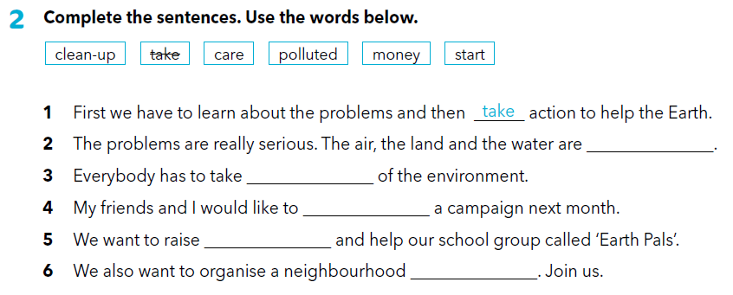
Workbook, p. 56
polluted
care
start
money
clean-up

Slide 8
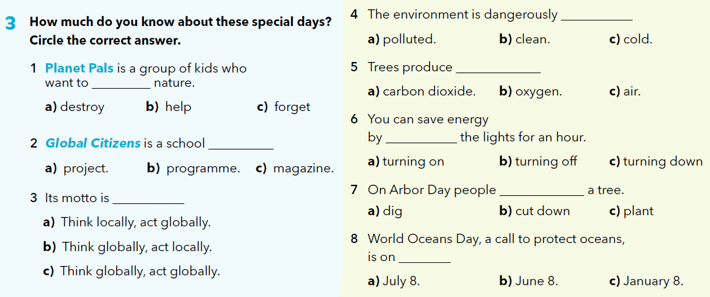


Slide 9
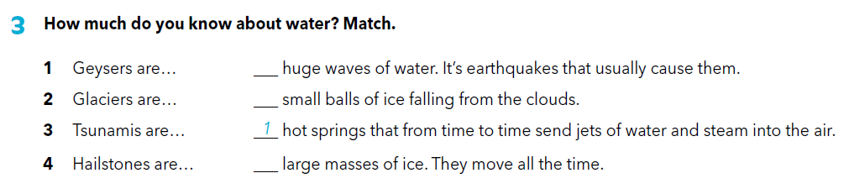
Workbook, p. 56
3
4
2
money

Slide 10
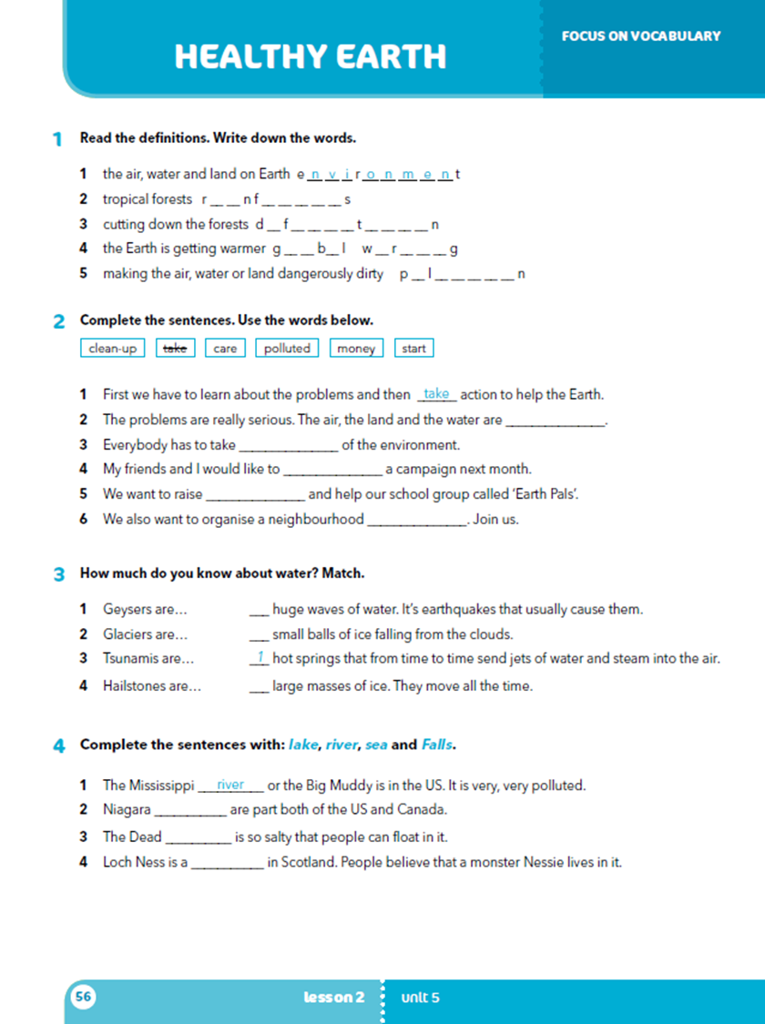
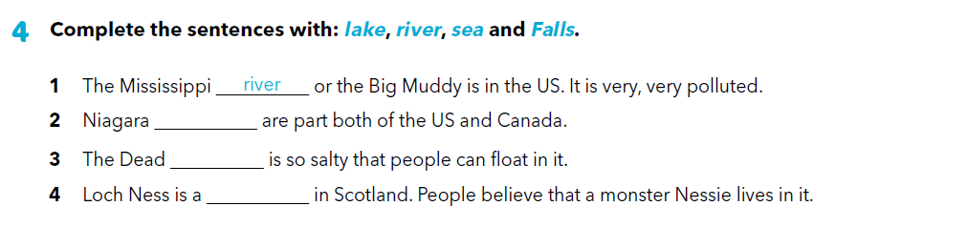
Falls
sea
lake
Practise: https://wordwall.net/play/1268/583/807
https://www.bookwidgets.com/play/SMKP5V

Slide 11
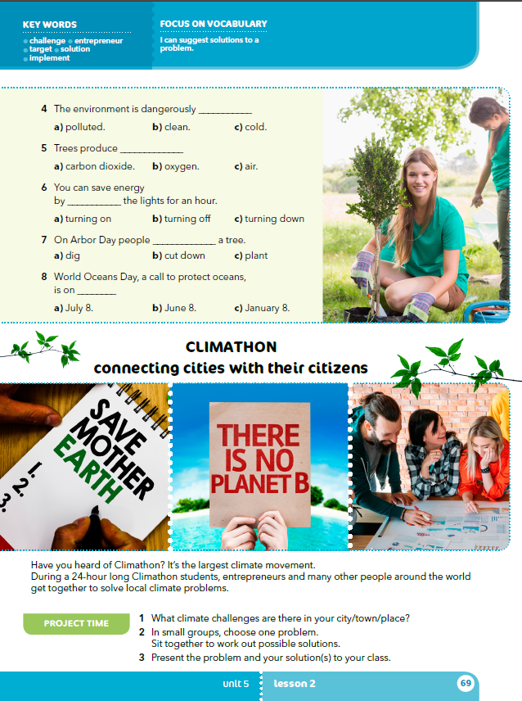
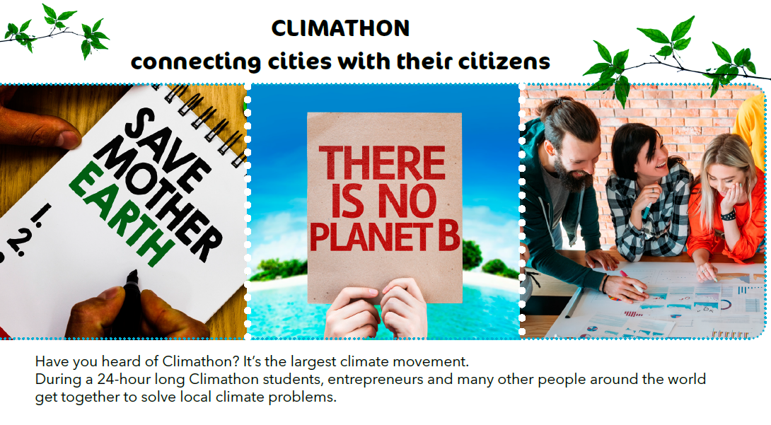
What are all the answers you could give if somebody asked you where you live?
Can you name some of the dangers our planet is facing?
What is deforestation and why is it bad for the world we live in?
What can ordinary people, including us, do for the environment?
Which special days are there that motivate us to do something for our planet?
How would you motivate a great number of people to act?
Click for more info: https://younginnovators.climate-kic.org/about-the-programme/young-climathon/

Slide 12

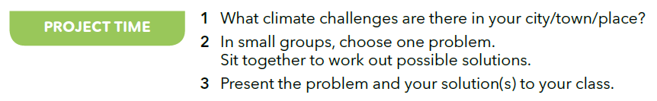
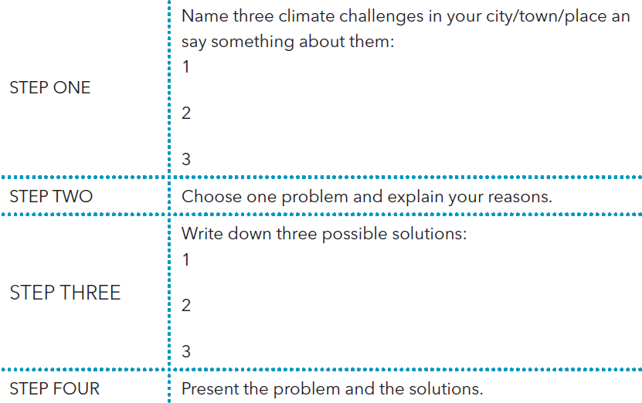

Slide 13

LEARN MORE
https://www.e-sfera.hr/dodatni-digitalni-sadrzaji/7481817e-5b32-4812-a961-9b2d65e0e498/
An Eco-Quiz

